Slide 1
Module 1: The Basics of Input-Output Analysis 1.1 Interindustry analysis and theoretical background
April 2025

Slide 2
The Basics of Input-Output Analysis
Interindustry analysis and fundamental intuitions
The Input-output framework was first created by Wassily Leontief (1936, 1941) with the purpose of performing interindustry analysis
Input-output analysis = an analysis of the interdependence of industries in an economy
In an economy, factors of production (capital, labor, land, and others) are mobilized in interlinked and complex productive processes and networks that involve multiple national industries and, often, industries located abroad
A fundamental goal of these productive processes is to provide goods and services to the society, satisfying the aggregated demand of the economy
Households (families), government, investment and exports are some of the components of the aggregated demand
Examples: households buy groceries, government buys work instruments for its public servants (pen, paper, etc.), entrepreneurs buy machinery and equipment to start a new business, other countries demand goods produced nationally

Slide 3
The Basics of Input-Output Analysis
Interindustry analysis and fundamental intuitions
Let’s take the example of pens which are demanded by the government:
The industry of writing instruments that fabricates pens demands inputs from other industries such as ink, plastic tubes, and pen tips made of metal
Labor and capital are also employed not only by the writing instruments industry for pen production, but also by the other industries supplying the pen industry
It is also the case that the chemicals, plastic and metal manufacturing industries that supply the industry of writing instruments also demand inputs from each other (e.g. some chemical components are needed by the plastic manufacturing industries)
It is possible to trace back the supply needs of the industry of writing instruments until its “most upstream activities”, where one could find the activities of raw materials extraction, for instance
In addition, there is an issue related to the levels of industry disaggregation
From a more aggregated point-of-view, the industry of writing instruments can be integrated in a broader industry of manufacture of plastics products
Ultimately, the level of disaggregation to be employed depends on data availability and on research objectives

Slide 4
The Basics of Input-Output Analysis
Interindustry analysis and fundamental intuitions
The interindustry analysis provided by the input-output framework is a tool that provides a broader and clearer understanding of the complex interactions of the productive network
From the point-of-view of an individual industrial sector, one can study its upstream network of inputs and, separately, its downstream network of output allocation
The upstream network can also be named backward linkages
The downstream network can also be named forward linkages
Backward and forwards linkages can also be divided into direct and indirect linkages
Direct linkages relate to the industries that are immediately connected to the analyzed industry (e.g. the connection between the industry of writing instruments and the industry of metal manufacturing providing the pen tips)
Indirect linkages relate to the industries that are connected beyond in the upstream and downstream networks of production (e.g. the connection between steel-made pen tips and pig iron extraction could be characterized as an indirect backward linkage)

Slide 5
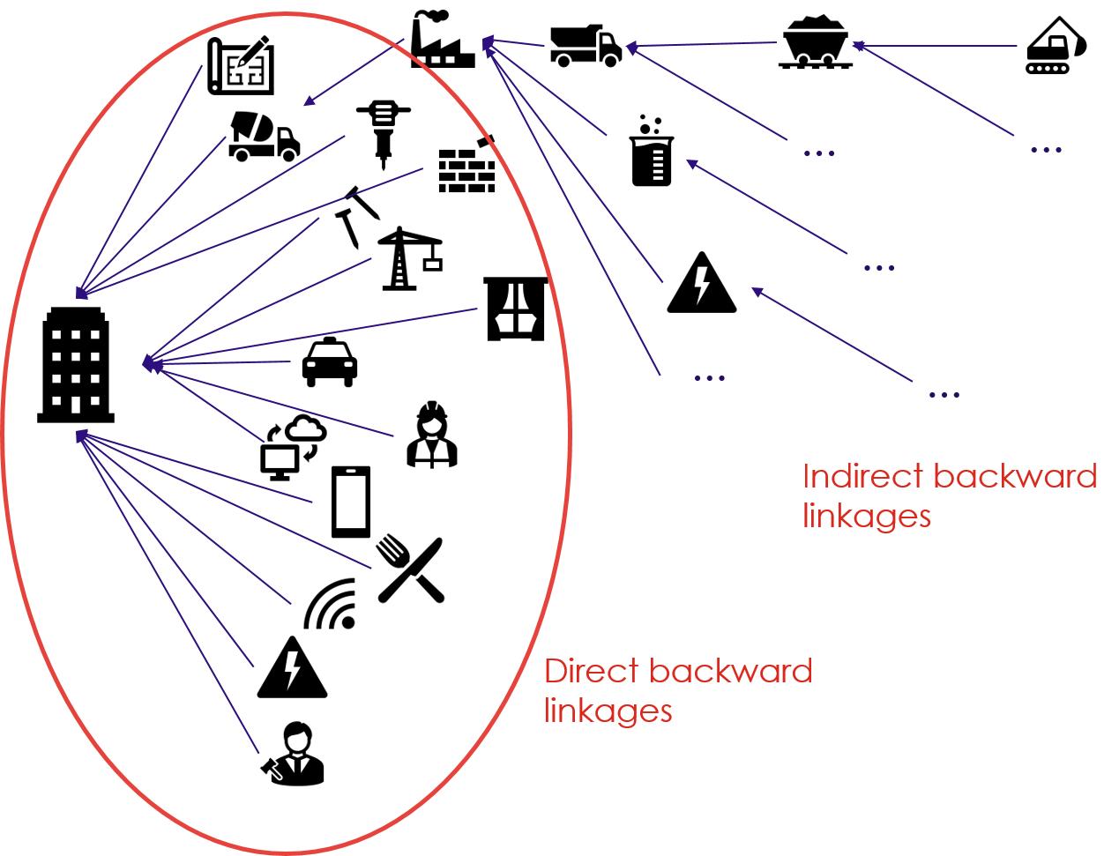
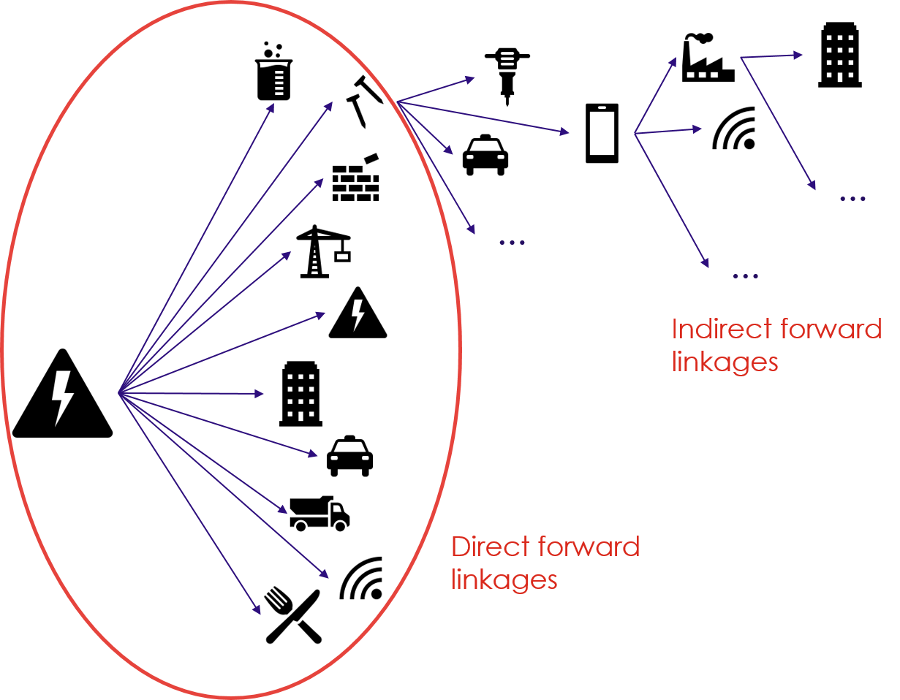
The Basics of Input-Output Analysis
Interindustry analysis and fundamental intuitions
The images below illustrate direct and indirect backward linkages of the housing industry (on the left), and direct and indirect forward linkages of the energy industry (on the right)
It should be highlighted that some industries are usually located more upstream or downstream in the broader picture of the productive network
For instance, the energy industry is well-known to be an upstream industry that supplies to basically all the other industries of the economy

Slide 6
The Basics of Input-Output Analysis
Interindustry analysis and fundamental intuitions
The input-output framework is able to capture the backward and forward linkages of the multiple industries of an economy, as well as the factors of production employed and the different final demand components
It produces a “snapshot” of an economy in a defined period
This “snapshot” is organized in a highly detailed table table, the Input-Output Table (IO Tables)
An Input-Output Table traces and displays all inputs (elements needed for production) and all outputs (outcome of production process) by industries of an economy in a given period
Periods are usually defined yearly
IO Tables usually display information in monetary terms (often in current prices, but could also be in other years’ prices)
There are also IO Tables which display information in quantities (e.g. car units or tons of production)

Slide 7
The Basics of Input-Output Analysis
Interindustry analysis and fundamental intuitions
A domestic Input-Output Table contains the following components:
A matrix of interindustry consumption (industry by industry)
A matrix (or vector) of final demand (industry by final demand component)
A vector of total output (by industry)
A value-added matrix that displays the remuneration of the factors of production
The details and structure of each matrix will be presented in the next lesson
The information contained in IO Tables regarding interindustry input and output relations can be modeled in order to better examine these relations
In this case we enter the world of Input-Output Models
The standard Input-Output Modeling techniques establish linear interindustry input and output relations, consisting of a system of linear equations
Each equation describes the distribution of an industry output throughout the economy
The linear nature of the system allows the model to be operated through matrix algebra

Slide 8
The Basics of Input-Output Analysis
Interindustry analysis and fundamental intuitions
What Input-Output Models (IO Models) are not or cannot do?
Standard IO Models are not economic growth models per se, although they could be adapted into growth models
Standard IO Models are not dynamic, although they could be transformed to be. They are a static picture of the economy in a given accounting period
Standard IO Models establish linear relationships between the sectors which leads to the modeling assumption of constant returns to scale
Standard IO Models per se do not contain financial information, although they could be adapted to contain it
What IO Models are or can do?
Standard IO Tables can be complemented with extensions containing additional details of the economic activity, which can also be modeled within IO Models
e.g. environmental/employment/capital use information at industrial level could be attached to IO Models
IO Models can be combined with other forms of economic modeling
e.g. they can be made Stock and Flow Consistent (SFC) or adapted together with Computable General Equilibrium Models (CGE Models)
Although Standard IO Models do not simulate future technological change, they are a great tool to assess past technological changes affecting the productive structure

Slide 9
Suggested Readings:
Textbooks, Leontief’s fundamental texts and further readings
Textbooks:
Miller, R. E., & Blair, P. D. (2021). Input-Output Analysis: Foundations and Extensions (3rd ed.). Cambridge University Press. https://doi.org/10.1017/9781108676212
Raa, T. ten (Ed.). (2017). Handbook of input-output analysis. Edward Elgar Publishing. https://doi.org/10.4337/9781783476329
Fundamental texts:
Leontief, W. W. (1936). Quantitative Input and Output Relations in the Economic Systems of the United States. The Review of Economics and Statistics, 18(3), 105. https://doi.org/10.2307/1927837
Leontief, W. (1991[1928]). The economy as a circular flow. Structural Change and Economic Dynamics, 2(1), 181–212. https://doi.org/10.1016/0954-349X(91)90012-H

